Slide 1
Erosion in Poland
This project has been funded with support from the European Commission.
This publication reflects the views only of the author, and the Commision cannot be held responsible for any use which may be of the information contained therein.
Notes:
1

Slide 2
Erosion is the proces by which soil and rock are removed from the Earth’s surface by different agents such as wind, rain or water flow, and then transported and deposited in other locations.
The proces can happen quickly or take thousands of years.

Slide 3
Types of erosion
Geologic
„natural” erosion caused by the action of the wind, water, ice and gravity. It is relatively slow, continuous proces that often goes unnoticed.
Accelerated
The speeding up of erosion caused by human activity.

Slide 4
The three main forces that cause erosion are wind, ice and water.
Wind erosion – light objects like rocks or pebbles are carried by the wind, then hit landforms and erode materials off them. It usually occurs in dry areas.
Glacier erosion – giant bodies of ice may pick up huge pieces of rock.
Notes:
4

Slide 5
Water erosion
Rainfall can cause erosion when rain hits the surface of the Earth (splash erosion) and when raindrops accumulate and flow like small streams.
Rivers break up pieces along the river bottom and carry them downstream.

Slide 6
Water erosion
Waves can cause the coastline to erode. Sea erosion is also created by salt and other chemicals in sea water which can erode weak rocks on the coast.
Floods act like powerful rivers which can cause erosion to happen very quickly.

Slide 7
Other forces causing erosion
Small living organism which break up the soil so it is easier for the wind and water to carry away.
Gravity can cause erosion by pulling rocks and other objects down the slide of a mountain or cliff.

Slide 8
Other forces causing erosion
Human activity - wrong use and abuse of natural resources, for example deforestation, logging, faulty farming systems, mining, high crop intensity or building new roads and urbanization.
Climate changes.

Slide 9
A water erosion experiment

Slide 10
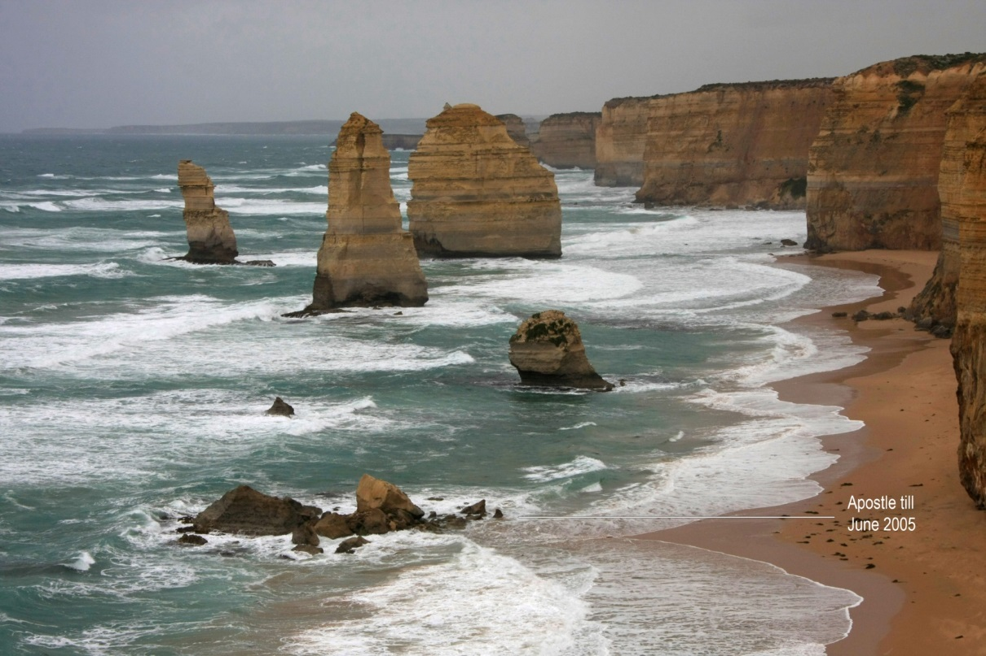
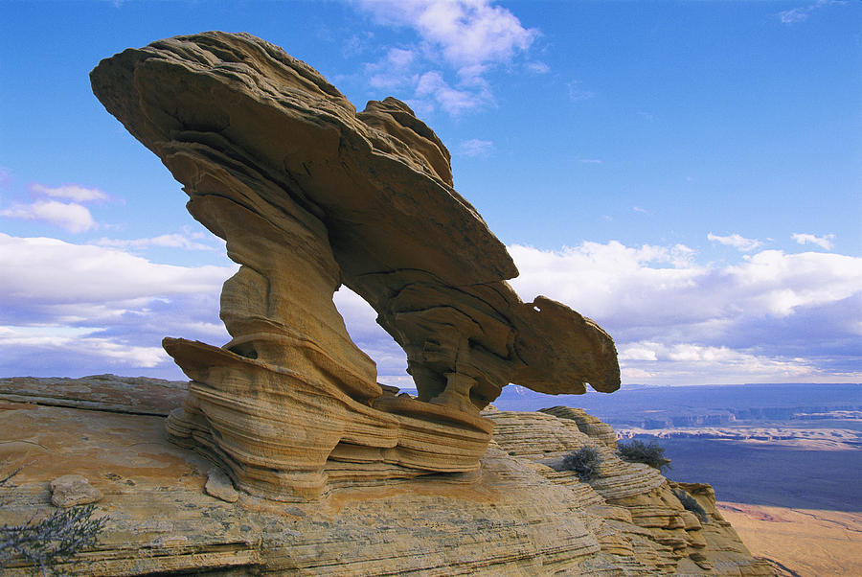
Thanks to erosion a lot of interesting
objects appeared on the Earth’s surface,
such as mountain peaks, valleys
and coastlines.

Slide 11
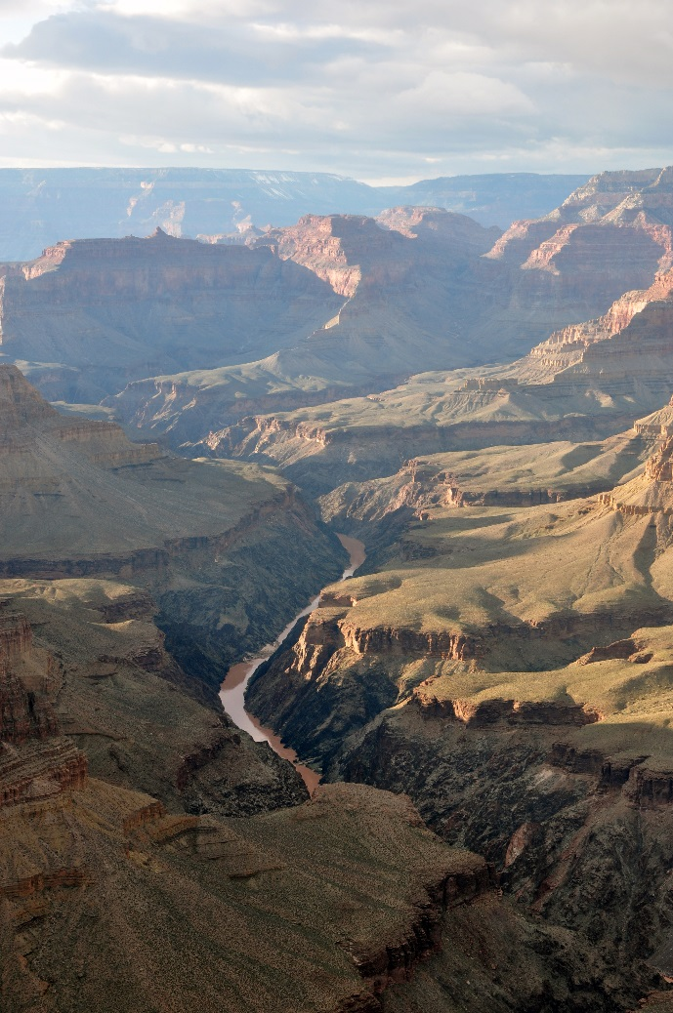
Grand Canyon (the USA)

Slide 12
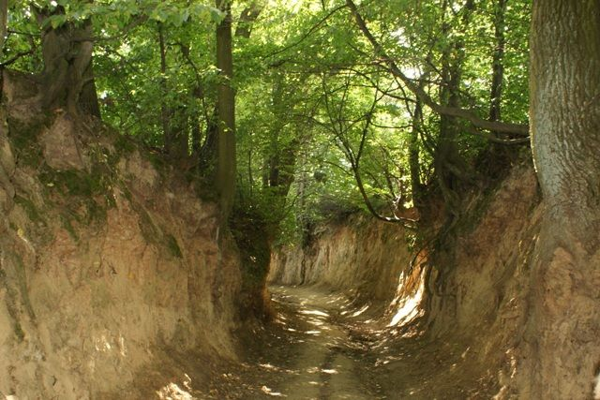
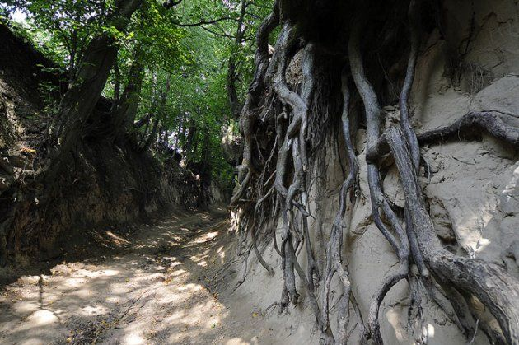
Poland
The oldest examples of erosion are in Wąwóz Korzeniowy
in Kazimierz Dolny, lubelskie voivodeship
In the past it was used as a road.

Slide 13
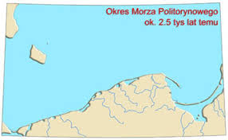
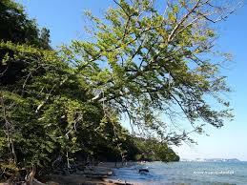
The coast of Baltic Sea 2500 years ago
Gdynia – erosion of sea coast

Slide 14
Consequences of erosion
loss of soil
breakdown in soil structure
and a decline in organic matter
reduction of soil moisture
increased risk of flooding
reduction of the capacity of rivers
shortening of the design life of reservoirs

Slide 15
Erosion is a natural process so it is not possible to stop it.
However, people can slow the proces by planting trees or setting embankments up the places where floods happen quite often.
Another idea is wise planning of building new cities, roads etc.

Slide 16
The end
Notes:
16

