Slide 1
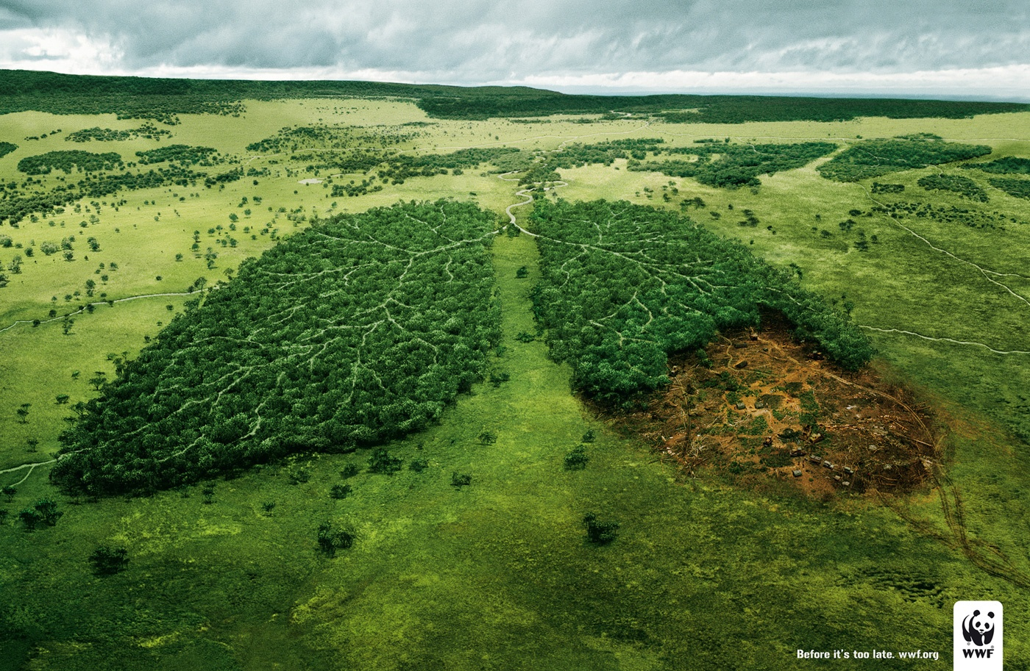
Deforestation
Patrycja Gajo
kl. VIa

Slide 2
What is deforestation?
Deforestation is destruction of trees

Slide 3
By men

Slide 4
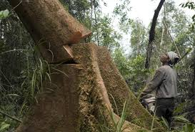
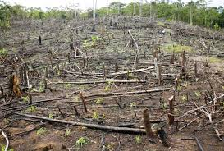
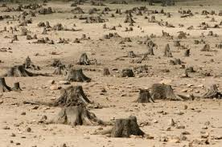
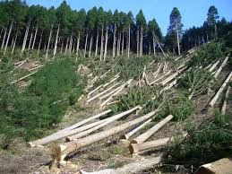
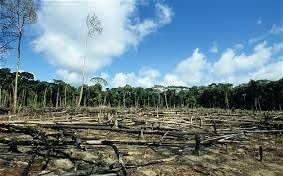
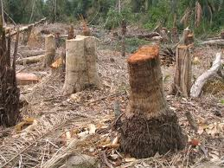

Slide 5
By NATURE

Slide 6
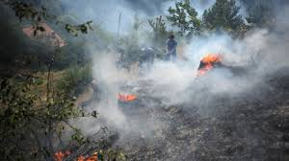
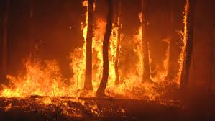
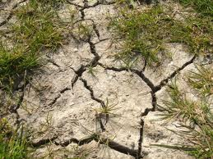
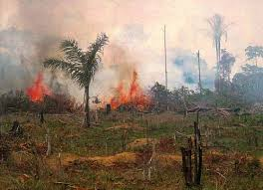

Slide 7
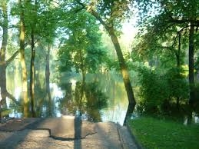
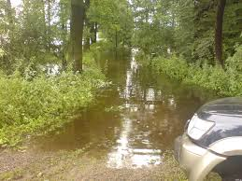
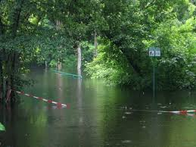

Slide 8
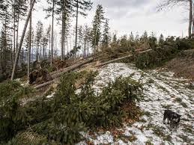
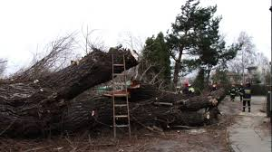
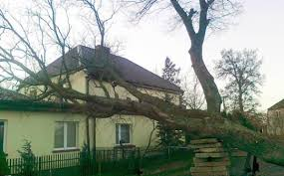

Slide 9
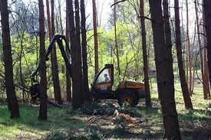
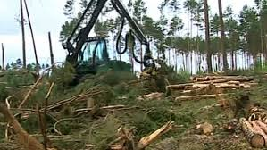
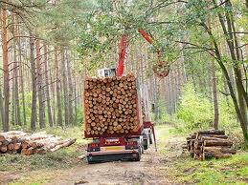
Why do people destroy forests?

Slide 10
There are a lot of causes,
but the most common are:

Slide 11
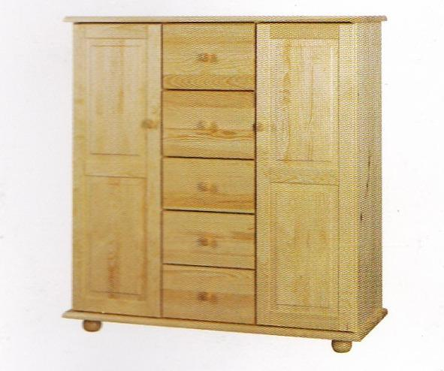
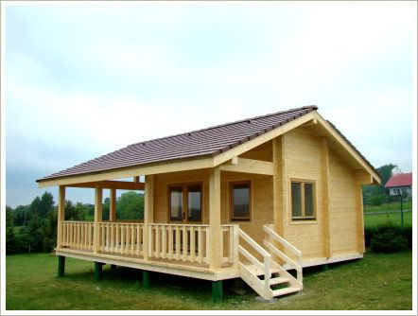
trees as building material

Slide 12
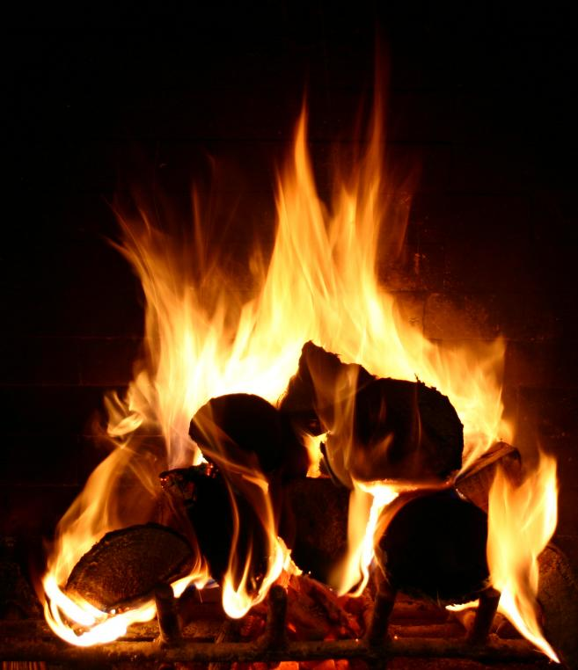
trees as fuel,
also in the form
of charcoal

Slide 13
trees as fuel or timber

Slide 14
convertion of forestland
in order to get new area
for farms or urban use

Slide 15
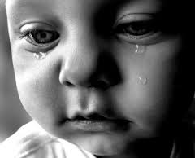
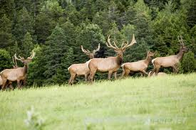
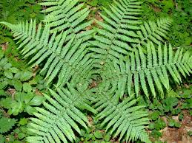
Who suffers from deforestation?
People
Animals
Plants and whole nature

Slide 16
The causes of deforestation
There are environmental problems caused by deforestation, such as:
Changes in climate – deforestation contributes to global warming.
Hydrological negative effects – reduction of water in the soil,
underwater and atmosferic moisture. As a result erosion,
landslide and floods occur.
Changes in biodiveristy – deforestation as a cause of extinction
of many species
There are also negative economical effects known.

Slide 17
Forests in Poland
yesterday
and today

Slide 18
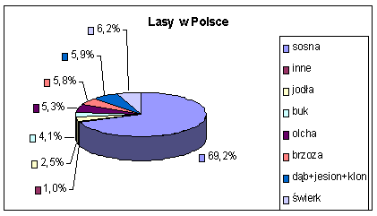
Trees in Poland
The most common trees in Polish forests are pines (almost 70%),
then spruce (6,2%), oak, ash, maple and birch

Slide 19
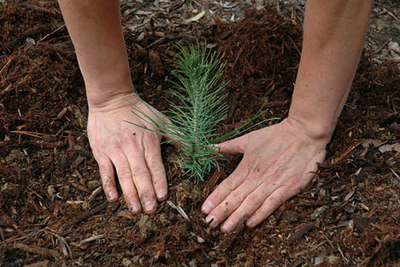
How can we prevent deforestation?

Slide 20
The government should
spend money on forests,
control and monitor the proces of deforestation,
People should
not cut down many trees,
reforestate,
afforestate,

Slide 21
Reforestation
the reestablishment of forest cover
by direct seeding or planting
and afforestation
the reestablishment of forest in areas
where there were no forests

Slide 22
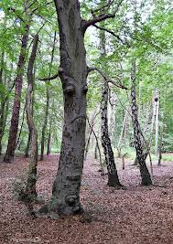
Men! Think of me! -
Forests
If we want the Earth was our home we must take care of it. We can’t destroy it, in particular the forests - green lungs of the Earth.

Slide 23
Thank you for your attention
Sources:
www.google.pl-Grafika
http://www.wosna5.pl/organizacje_ekologiczne
This project has been funded with support from the European Commission.
This publication reflects the views only of the author, and the Commision cannot be held responsible for any use which may be of the information contained therein.

