Slide 1
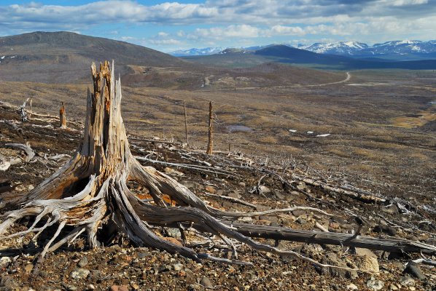
DEFORESTATION
Deforestation is clearing Earth's forests on a massive scale, often resulting in damage to the quality of the land. Forests still cover about 30 percent of the world’s land area, , but the size of forest are lost each and every year. The world’s rainforests could completely vanish in a hundred years at the current rate of deforestation.

Slide 2
The causes of deforestation
AGRICULTURE
Dams
Forest fire
Mining

Slide 3
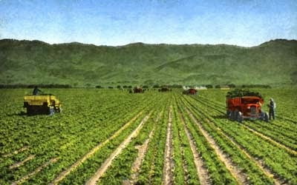
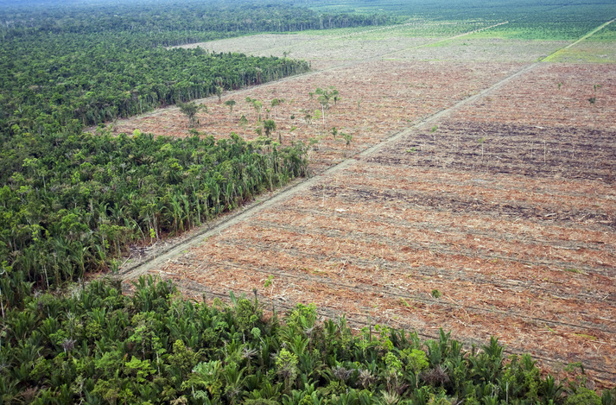
Agriculture
The biggest driver of deforestation is agriculture. Forests are cut down for many reasons but most of them are people’s need to provide for their families. Farmers cut forests to provide more room for planting product or grazing livestock.
Often many small farmers will each clear a few acres to feed their families by cutting down trees and burning them in a process known as “slash and burn” agriculture.

Slide 4
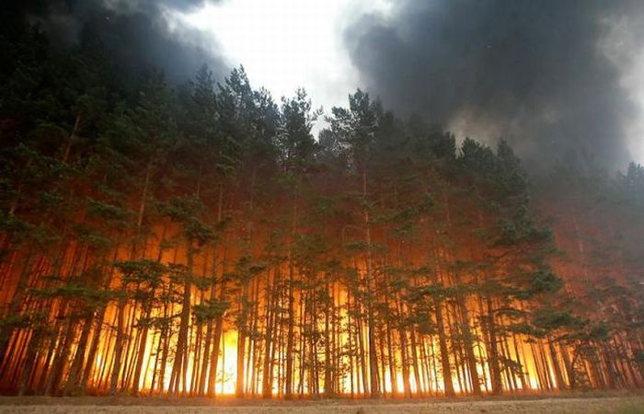
forest fire
Not all deforestation is intentional. Some is caused by a combination of human and natural factors like forest fire which may prevent the growth of young trees.

Slide 5
DAMS
Since the construction of dam take up lot of space, it is required many large area to build of dams. This is directly related the deforestation because many forest is destroyed from people to build dam. Also, to build a hydroelectric dam, acres of land must be flooded, which causes deforestation.

Slide 6
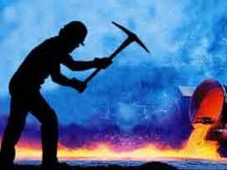
mining
Mining also results in deforestation. Digging a coal, diamond or gold mine requires the removal of all forest cover, not just for the mines but also for trucks and equipment.

